Slide 1
A Jovial Jaunt into Java
Or how I learned to stop worrying and love the commit
Joseph Beckett

Slide 2
Contents

Slide 3
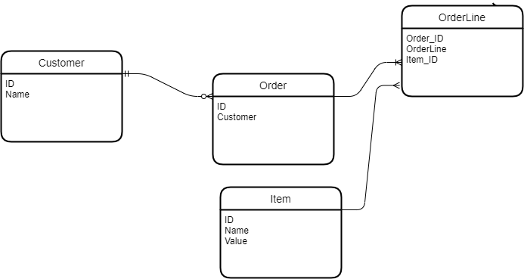
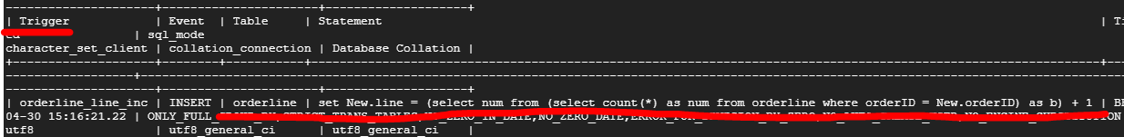
Initial stages
Construct a logical Database table Structure
Note the orderline connector here
In local host able to use “ENGINE=MYISAM” to generate a 2 part key where the second auto increments seperatly for every new first part entry
GCP disallows this workaround however, so we make use of SQL triggers to replicate that functionality.

Slide 4
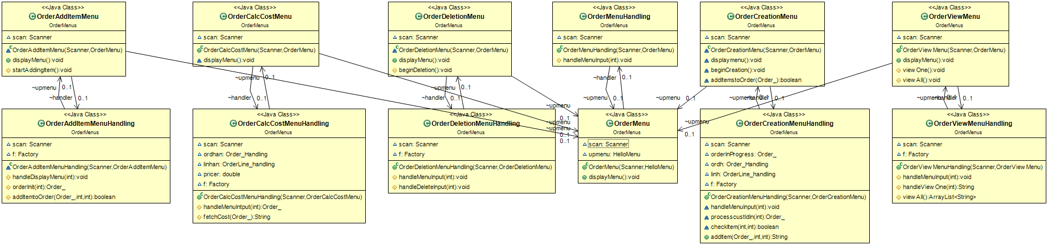
Initial Stages
Constructing a UI
Command line UI must be sure to be informative, minimal, logical
Chose a branching tree structure with classes dedicated to “syso/scan” working with their own handlers to communicate with the rest of the project.
Three trees – customer, Order, Item mimicking the 3 main tables in our database.

Slide 5
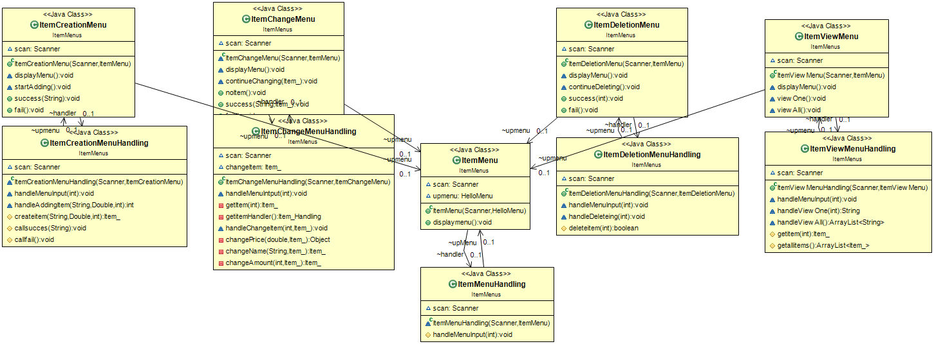
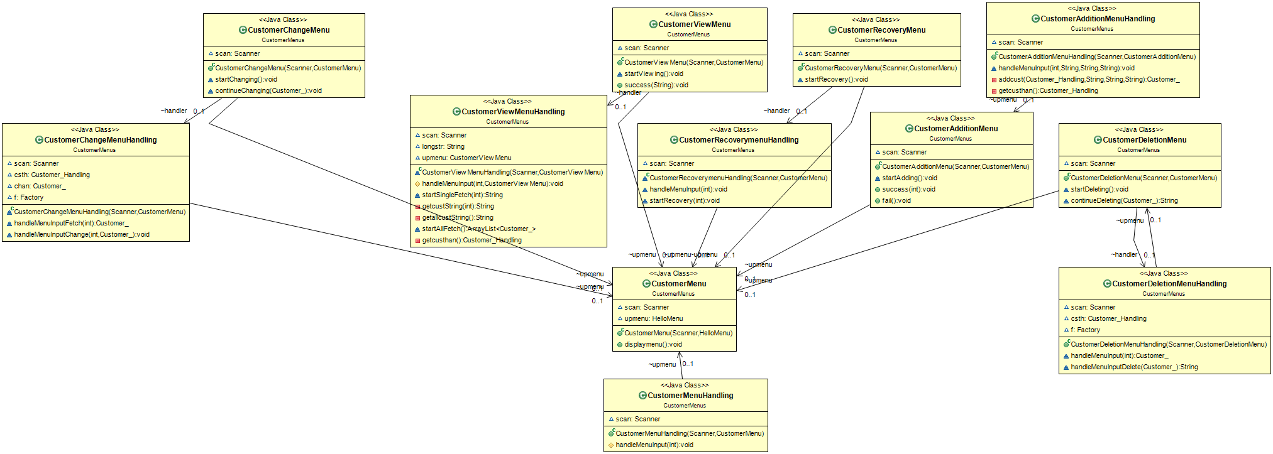
The item and Customer structures follow much the same pattern

Slide 6
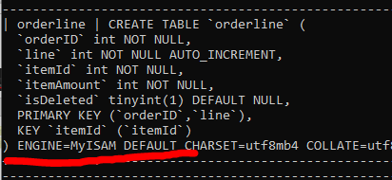
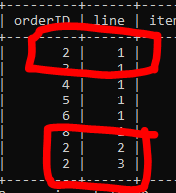
Creating our database
Following the initial draft structure
We can create tables as such
Of note is the need for orderline to follow a pattern as below
This ensures that we can add items to an order at any
Point and still have a unique key for that line, along with
Being able to fetch all lines for one order very simply.

Slide 7
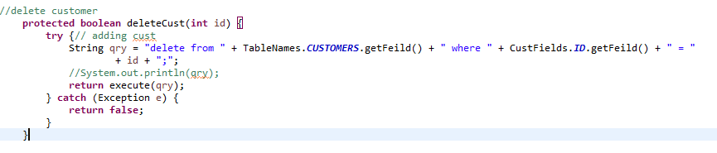
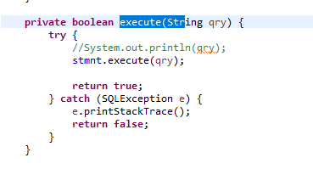
Tying our database to our UI
First we need a class to handle connections and statements with as little processing as possible
Cue Database_.class
Handles query forming and Result
Passing without computation

Slide 8
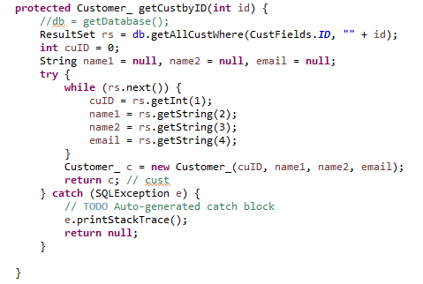
Dealing with ResultSets
We need to turn our ResultSets and Booleans into meaningful objects
As well as telling our Database_ class what querys to execute.
Database Handler is tasked with the bulk of translating requests into a format our Database can comprehend
Additionally receiving the results and
Returning useful data to the requestor

Slide 9
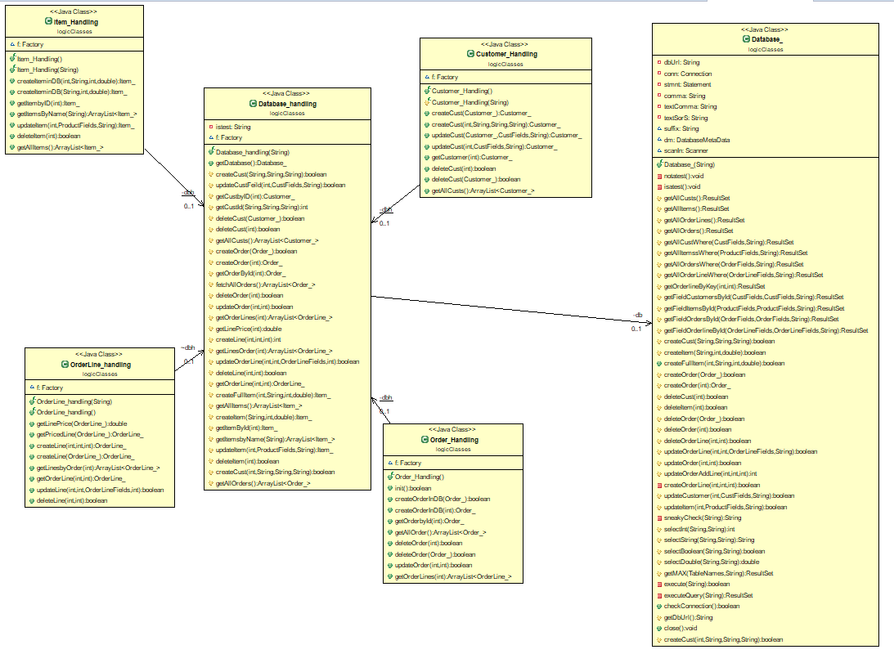
Conversing with Handlers

Slide 10
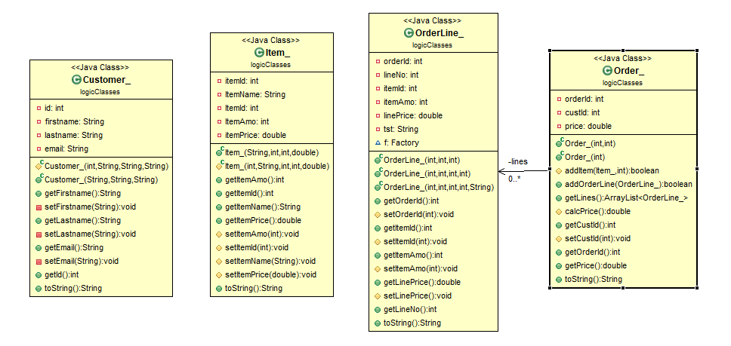
Modelling our objects
This is all fine but to progress we need representation objects of out databse rows/tables

Slide 11
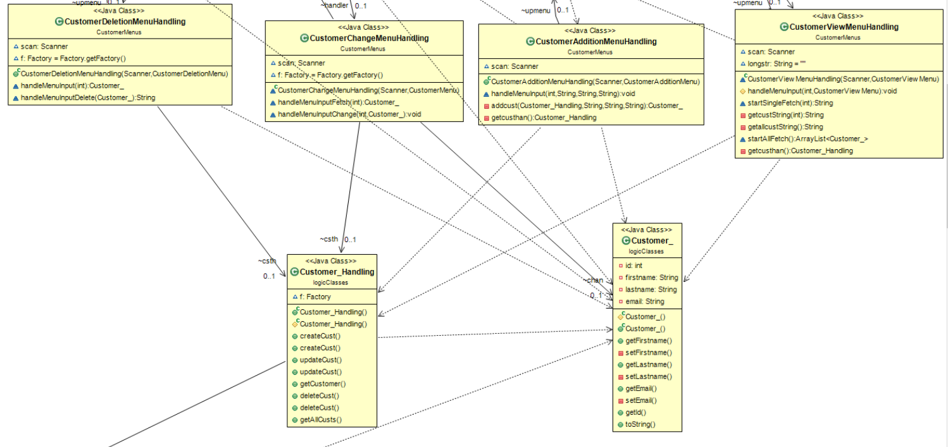
Tying the UI to the Handlers

Slide 12
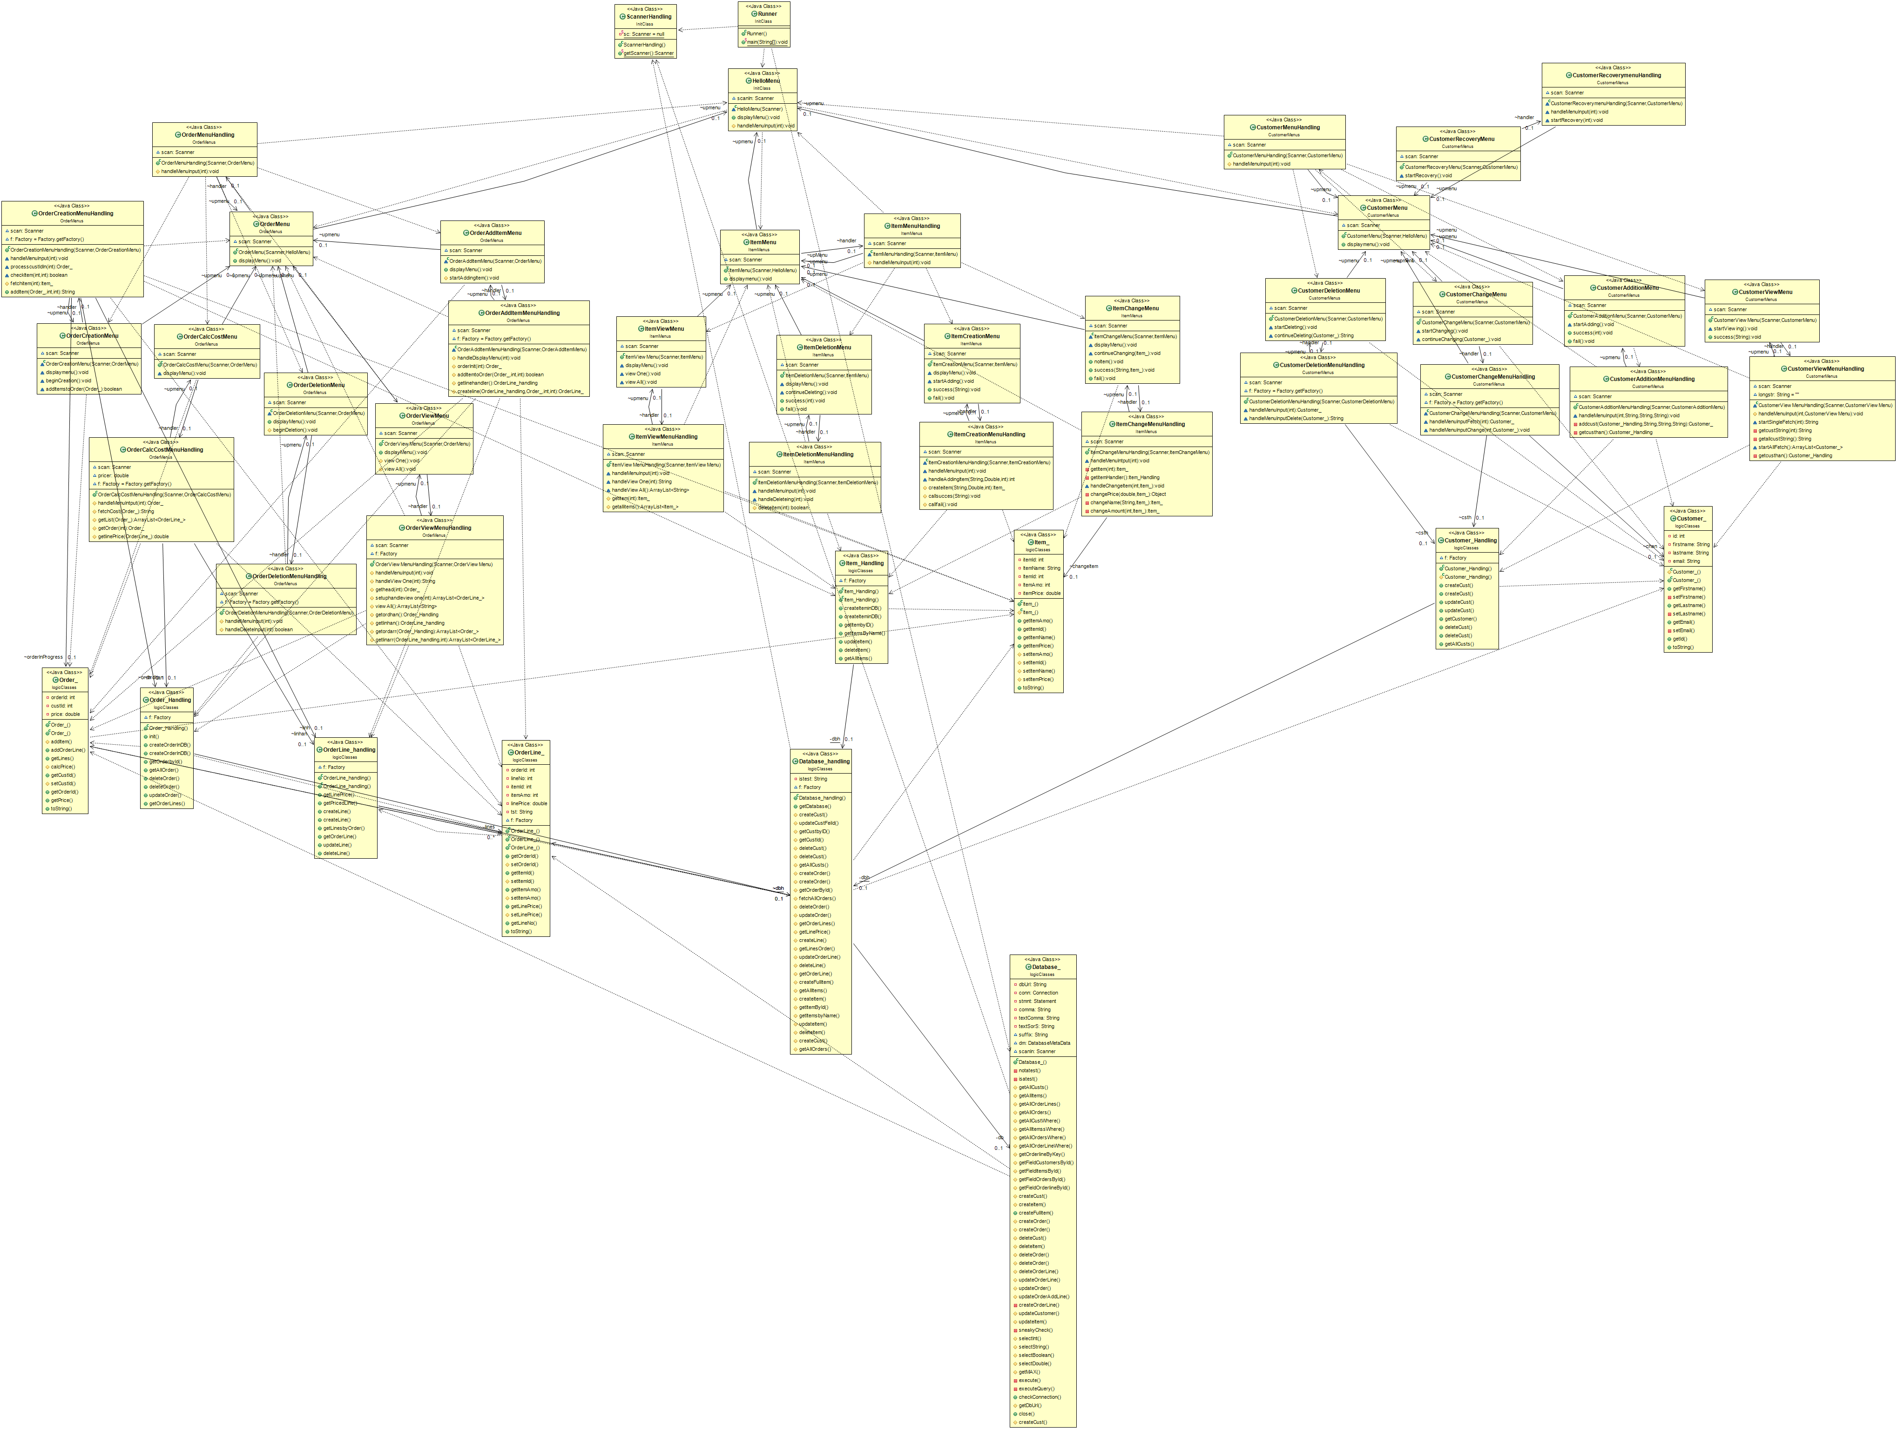

Slide 13
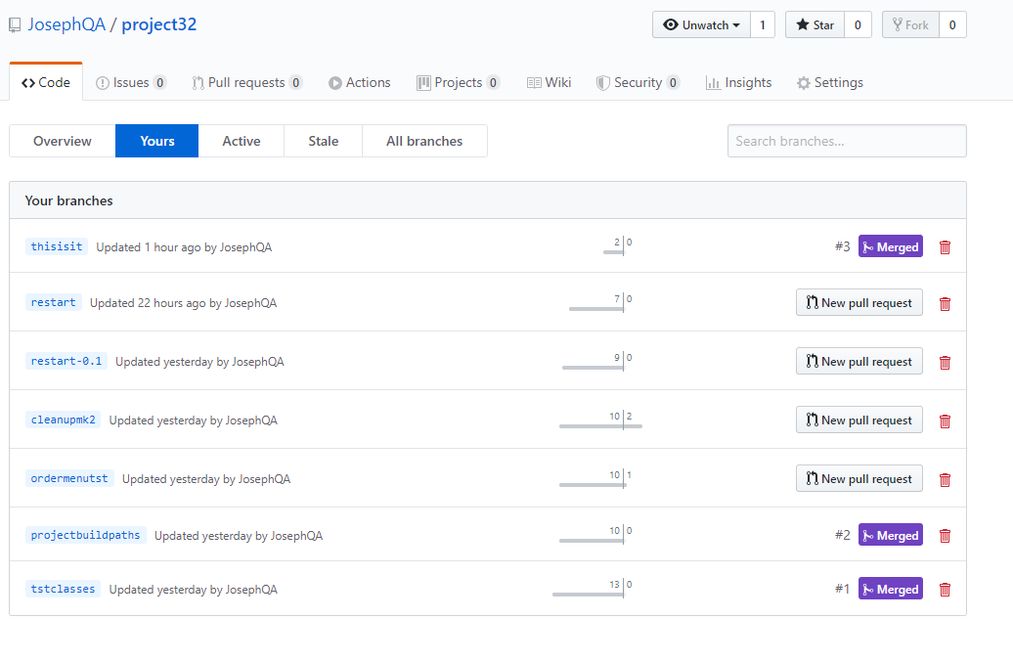
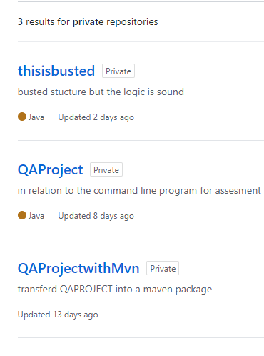
GIT ….. Various issues and resets led to 4 total Repos. Initially without maven, new project with maven. Then Pom Dependencies threw me in the deep end. Thanks to Savannah, Vinesh, Julian for helping sort that out

Slide 14
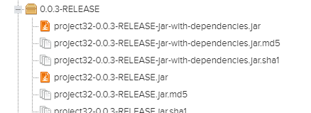
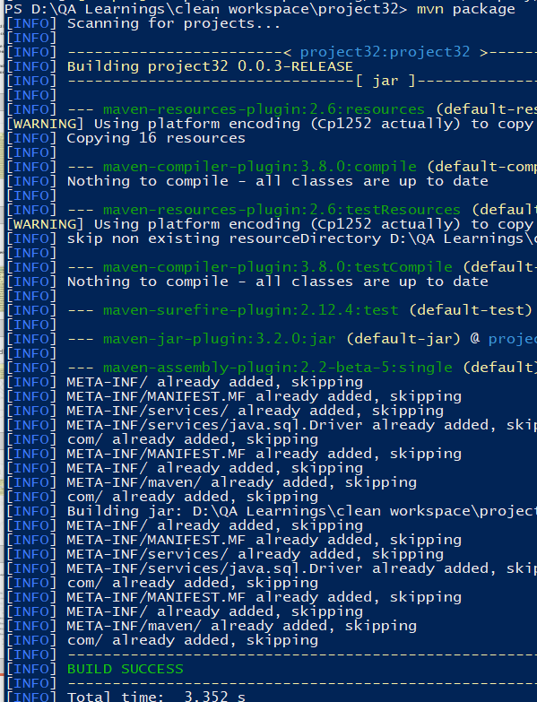
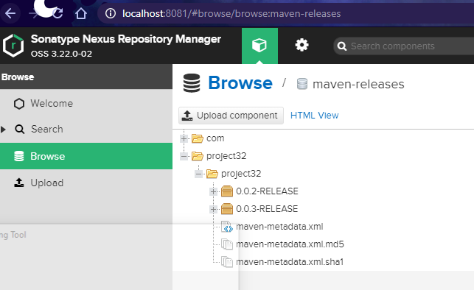
Maven and Nexus

Slide 15
Testing
After implementing a few test classes. Running coverage would cause my entire project to implode .
This took Days to get sorted. And I had no idea why it was happening for most of that time
As a result testing was limited to mainly methods called by the handlers to CRUD in database.
These tests showed errors with my SQL qry formation and were most helpful.
The bulk of the UI has only been tested by using it to see what goes wrong. This also resulted in better comprehension of how my UI elelments should talk to each other and their handlers.

Slide 16
CUE WALKTHROUGH

Slide 17
My Journey
Maven/nexus - very thick brick wall
Java - being able to remember the basics from my past life helped a lot to begin with. But currently at my highest level of java comprehension
SQL - I’ve used a lot of queries before but the formation of tables and using mySQL was a real eyeopener
Work ethic – needs more direction.
GCP – the cloud is just a computer “over there”
Deliverable - meets spec.

Slide 18
Question Time
HIT ME WITH A QUESTION I DARE YOU XD

